Slide 1


EU AI Act 2024/1689
Compliance
Guidance on high-risk requirements of the EU AI Act 2024/1689 in light of proposed provisions for forthcoming change
Changes Pending Approval
Proposal dated 16 December 2025
Commission Proposal to amend MD Regulation and Annexes — concise overview of impact related AI Act
Niamh St John Lynch, Digital Health Task Force Member
Presenter, DkIT PhD Researcher/Lecturer
Notes:
The Commission’s proposal explicitly amends Regulation (EU) 2024/1689 (the AI Act) “as regards the list of Union harmonisation legislation referred to in its Annex I.” This means the MDR (Regulation (EU) 2017/745) and IVDR (Regulation (EU) 2017/746) are confirmed and updated as harmonised legislation under the AI Act, ensuring alignment between the regulatory frameworks for medical devices and AI systems.
AI systems that are part of or used as medical devices fall squarely under the “high‑risk AI” category in the AI Act, and the MDR remains the governing product‑specific legislation within that category.
The 16 December 2025 proposal highlights that one of its explicit objectives is to “provide clarity on the rules applicable to devices incorporating Artificial Intelligence (AI).
The 2025 proposal reinforces this alignment by:
Updating the Annex I reference within the AI Act.
Introducing clearer MDR pathways (e.g., for software, clinical data, well‑established technologies).
Reducing administrative burden, allowing manufacturers to comply with both MDR and AI Act requirements more predictably

Slide 2
Understanding the Scope of the MD proposed change in relation to the EU AI Act 2024/1689
AI Medical Devices are no longer fully subject to AI Act high-risk rules; only horizontal AI Act requirements apply – limited to Article 2(2) of the AIA.
What is the impact when developing AIeMD if the proposed change is adopted?
Change to the EU AI Act 2024/1689, moves the reference to MDR/IVDR from Section A to Section B of Annex I
Being in Section B of Annex I means you must apply Article 2(2) of the AI Act for high-risk AI systems
e.g., Article 107 – requirements set out in Chapter III Section 2 of 2024/1689 applies – to ensure AI systems are developed and used in a manner that is safe, trustworthy and respects fundamental rights
Article 2(2) says you need to comply with Article 6(1)
Article 6(1) indicates you need to apply Articles 102-109, 112 and 57 in so far as necessary.
Notes:
Article 8 section 2 states – that the AI Act as well as Union harmonised legislation shall be taken as requirements when listed in Section A of Annex I (ALL requirements apply).
By amending Annex I of the AI Act, the 16 Dec 2025 proposal ensures that:
MDR remains the sectorial product-safety law,
AI Act obligations apply on top of MDR,
Conformity assessments can be better synchronised between Notified Bodies (MDR) and AI Act requirements.
The 16 December 2025 European Commission proposal says that:
MDR and IVDR are formally integrated into the AI Act framework through amendments to Regulation (EU) 2024/1689, updating the list of harmonised legislation.
MDCG 2025-6 States “AI systems that qualify as high-risk AI systems under Article 6(1) AIA must comply with both MDR or IVDR and the AIA”.
It also states that “According to Article 43(3) AIA, for high-risk MDAI the requirements set in Articles 8 to 15 AIA and specific provisions related to the assessment of quality management system and technical documentation covered in Annex VII point 4.3, 4.4, 4.5, and the fifth paragraph of point 4.6 AIA must be assessed or taken into consideration as part of the conformity assessment procedure under MDR and IVDR”

Slide 3
Understanding the Scope of the MD proposed change in relation to the EU AI Act 2024/1689
AI Medical Devices are no longer fully subject to AI Act high-risk rules; only horizontal AI Act requirements apply – limited to Article 2(2) of the AIA.
What is the impact when developing AIeMD if the proposed change is adopted?
Will MDR/IVDR be added to this sub-set of regulations ensuring that ‘safety components’ using AI in medical devices will comply with Articles 8 – 15? Surely that was the original intent of moving MDR/IVDR from Section A to Section B of Annex I.
Change to the EU AI Act 2024/1689, moves the reference to MDR/IVDR from Section A to Section B of Annex I
Being in Section B of Annex I means you must apply Article 2(2) of the AI Act for high-risk AI systems
e.g., Article 107 – requirements set out in Chapter III Section 2 of 2024/1689 applies – to ensure AI systems are developed and used in a manner that is safe, trustworthy and respects fundamental rights
Article 2(2) says you need to comply with Article 6(1)
Article 6(1) indicates you need to apply Articles 102-109, 112 and 57 in so far as necessary.
Notes:
Section A lists all EU product‑safety laws that are part of the New Legislative Framework (NLF)—the EU’s modernised, harmonised approach to product compliance.
These include sectors such as:
Machinery
Toys
Lifts
ATEX (explosive atmospheres) equipment
Radio equipment
Pressure equipment
Cableway installations
Personal protective equipment
Gas appliances
Medical devices (MDR)
In vitro diagnostic devices (IVDR)
These laws already use NLF structures such as conformity assessment, CE marking, and harmonised standards. When an AI system is a product regulated under these laws, AI Act obligations integrate directly with existing NLF requirements
Section B lists other EU harmonisation laws that are not part of the NLF framework.
It captures legislation that still requires alignment with the AI Act but does not follow the NLF model of conformity assessment and CE marking. These may involve safety, transport, or sector‑specific regulatory regimes that intersect with AI systems.
Section B = Non‑NLF harmonisation laws still relevant to AI, but with different structures, enforcement pathways, or conformity systems compared to NLF product-safety laws
Interaction with MDR/IVDR - Still applicable, but integration pathway differs

Slide 4


What is a Safety Component under the AIA?
a component of a product or of an AI system which fulfils a safety function for that product or AI system, or the failure or malfunctioning of which endangers the health and safety of persons or property.
i.e., a component whose malfunction could endanger health, safety, or property. These examples are also informed by scenarios discussed in regulatory analysis relating to high‑risk AI safety components (AI Software, AI Algorithms, AI Data, etc.)
Notes:
MDR applies when software/device is intended for a medical purpose.
AI Act applies when software qualifies as an AI system and falls within a high‑risk use case (medical). Medical software can thus be regulated under both frameworks simultaneously.
According to the MDCG 2025-6, an AI Medical Device is considered high-risk under Article 6(1) AIA if it meets both of the following:
the AI MD is a safety component OR the AI system itself is a medical device; and
Is subject to conformity assessment by NB under MDR/IVDR

Slide 5


1
2
3
4
Article 8 – compliance with requirements; identify requirements for high-risk AI systems, taking into account the risk management system referred to in Article 9.
Article 9 – Risk management system.
Article 10 – Data and Data governance.
Article 11 – Technical documentation – drawn up and maintained.
Establish and maintain a risk management process.
Requirements for data quality and governance practices.
Create and keep up-to-date technical files for systems.
Chapter III Section 2: High-Risk AI Requirements Overview
Defines compliance duties and links to risk management.
5
6
7
8
Key obligations for design, validation, and governance
Article 12 – Record-keeping (e.g., event logs over lifetime of the system).
Article 13 – Transparency and provision of information to deployers.
Article 14 – Human oversight.
Article 15 – Accuracy, robustness and cybersecurity.
Measures to ensure meaningful human control and oversight.
Remember - all medical devices subject to Notified Body review are considered High-Risk under the EU AI Act.
Maintain lifecycle logs and event records.
Standards for system reliability and protection against threats.
Ensure clear information is provided to system deployers.
Notes:
Article 11: MDR technical documentation focuses on clinical evaluation, performance, safety, and software validation. 2025 proposal broadens acceptable clinical & non‑clinical evidence and allows proportionate requirements for “well‑established technologies

Slide 6
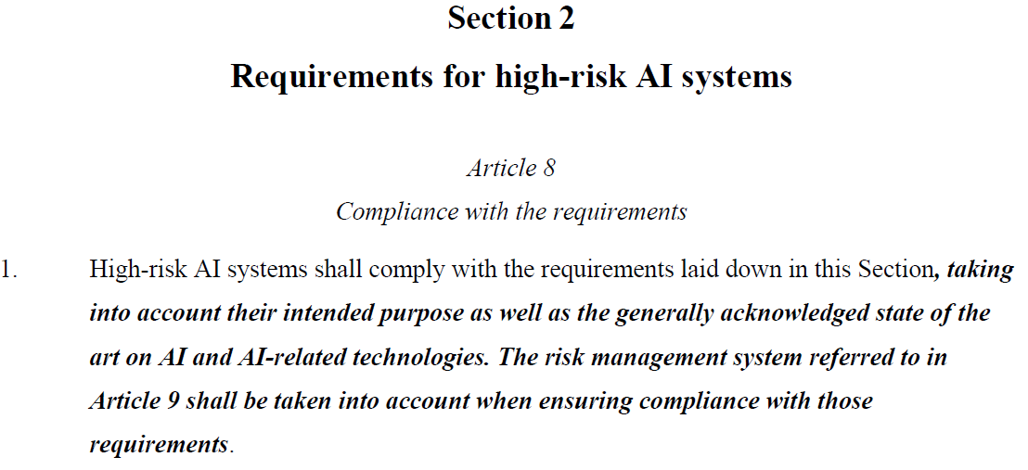
Article 8 Overview
Mandate for High‑Risk AI
Article 8 as the legal foundation for CE marking and market access across the European Union Article 8 establishes the core obligation: providers of high-risk AI systems must ensure their products strictly adhere to the requirements set out in Articles 9 through 15. Compliance is not optional; it is a legal prerequisite for the EU declaration of conformity and the application of the CE marking, signifying that the system meets the highest safety and ethical standards before being placed on the market.

Slide 7








Risk Management Lifecycle
Implementing Article 9 Through Systematic Risk Identification and Mitigation
Identification
Analysis & Estimation
Targeted Measures
Validation Testing
Systematically identify known and foreseeable risks to health, safety, and fundamental rights.
Analyze impact and estimate risk levels, including those arising from post-market monitoring data.
Adopt measures to address hazards, ensuring residual risk is acceptable and balanced.
Test systems under real-world conditions to confirm the effectiveness of risk management measures.
Notes:
MDCG 2025-6 reiterates this:
Risk management requirements specific to high-risk MDAI include ongoing assessments of known and reasonably foreseeable risks that the high-risk MDAI can pose to fundamental rights, data biases, and system robustness, including identification, analysis, and mitigation of risks related to system design, development, and deployment, and may include training to deployers. This includes measures to ensure the safety and reliability of high-risk MDAI in healthcare settings through comprehensive risk assessments, documentation of risk mitigation measures, and continuous monitoring of system performance.24 These requirements aim to prevent, and address known and reasonably foreseeable risks to ensure the safety and performance of MDAIs.
Manufacturers of high-risk MDAI may integrate the additional risk management requirements specific to MDAI set out in paragraphs 1-9 of Article 9 of the AIA into the testing, reporting processes, information and documentation required under the AIA into their existing documentation and procedures under the MDR and IVDR.

Slide 8






Testing for Residual Risk Acceptance
Strategic Approaches to Performance Validation and Design-Led Hazard Reduction
Risk Control
Real-World Testing: High-risk systems must undergo performance testing to ensure consistency with their intended purpose and safety profiles.
Risk Elimination by Design: Priority must be given to eliminating or reducing risks through inherently safe design and development practices.
Residual Information: Any remaining risks must be communicated to deployers, though this does not replace the need for design-based mitigation.

Slide 9

Five Pillars of Data Governance
Governance Oversight
Article 10 Mandates for High-Integrity Training and Validation Datasets
Data Management Policy / Procedures
Identification and addressing of data gaps or shortcomings that prevent regulatory compliance.
Suitability Assessment
Formal validation of dataset availability, independence, quantity, and overall suitability for the intended AI purpose.
Bias Mitigation
Examination of biases affecting safety or rights, followed by specific detection and prevention measures for sub-groups.
Preparation Steps
Structured annotation, labeling, cleaning, and aggregation to ensure data integrity and usability.
Collection & Origin
Defined design choices and data collection processes, including the original purpose for personal data.
Notes:
MDR has no explicit training data quality requirements beyond general software safety and performance.
AI Act mandates data governance rules, including quality, relevance, representativeness, and freedom from bias for training, testing & validation datasets
MDR has no explicit training data quality requirements beyond general software safety and performance.
According to MDCG 2025-6:
Article 10 AIA provides further specifications related to the data and datasets of AI systems. Moreover, it includes a provision for exceptional processing of special categories of personal data.26 These requirements aim to ensure that high-risk MDAI is built and validated on trustworthy data.
To ensure that MDAI performs as intended and safely, high-quality data plays a central role in providing structure and in ensuring performance, especially for the development of high-risk MDAI-based on machine learning techniques. High-quality data sets for training, validation and testing of MDAI require the implementation of appropriate data governance and management practices.
The data governance and management practices, in the case of personal data, should be fully compliant with the GDPR provisions and include transparency about the original purpose of the data collection
The requirements related to data governance can be complied with by having recourse to third parties that offer certified compliance services including verification of data governance.
To ensure comprehensive data governance practices for MDAIs, datasets for training, validation, and testing must be relevant, sufficiently representative, and, to the best extent possible, free of errors and complete.28 When training, validating and testing high-risk MDAI, manufacturers must ensure that the datasets are sufficiently representative of the target population, and in relation to the performance study population specifications on selection criteria and decisions related to the size of the performance study population are defined. 29 Manufacturers must implement procedures ensuring data transparency and integrity and examine the data in view of possible biases, with detailed documentation of compliance. For further information on generation on clinical evaluation (MDR) / performance evaluation (IVDR) of MDSW, see MDCG 2020-1.

Slide 10





Mitigating AI Discrimination
Bias Control
Special Category Data
Bias Mitigation Metrics
Exceptionally allowed for bias detection
Must implement top-tier security measures
Delete data once the bias is corrected
Examine impacts on protected groups
Identify gaps in geographic representation
Mitigate risks to fundamental rights
Notes:
Special Category Data means sensitive types of personal data, religious beliefs, ethnic origin, political opinion, biometric data, sexual orientation. Genetic data, union membership, etc. Normally processing this type of data is prohibited unless an explicit legal basis applies (see Article 9 of GDPR). AI Act recognises that some biases in AI systems cannot be detected or corrected without examining sensitive attributes. E.g., AI hiring tool may need knowledge of ethnicity in the dataset to mitigate bias. Article 10(5) permits process of special category data where it is strictly necessary for detecting, monitoring, correcting bias in high risk AI systems. There is still a call for attention to this point, because GDPR does not currently allow for bias detection as a lawful exception.
SCA – cannot be used for training the AI system.
MDR has no explicit training data quality requirements beyond general software safety and performance.
AI Act mandates data governance rules, including quality, relevance, representativeness, and freedom from bias for training, testing & validation datasets.
MDCG 2025-6 says:
The AIA requires high-risk MDAI manufacturers to implement data governance and management practices appropriate for the claimed intended purpose, including with a view of possible biases that are likely to affect the health and safety of persons, have a negative impact on fundamental rights or lead to discrimination prohibited under Union law, especially where data outputs influence inputs for future operations.
Furthermore, manufacturers must implement appropriate measures to detect, prevent and mitigate possible biases identified.
Furthermore, the requirements for appropriate record keeping include logging capabilities as part of post-market monitoring. The aim is to ensure that manufacturers put in place appropriate mechanisms to detect possible bias not originally detected in pre-market activities but rather as a result post-market monitoring or learning.
the Commission will provide horizontal guidelines on the practical implementation of Article 10 AI act on data and data governance which will provide further clarifications on the meaning and practical application of this provision

Slide 11









Article 11
Technical Documentation
System Description:
Version details,
intended purpose, and interaction with other hardware/ software components.
Development Process:
Full documentation of methods, steps, and reliance on pre-trained systems or third-party tools.
Evaluating Pre-Trained 3rd Party AI Models in MDSD for Responsible and Ethical Use
IEC 62304 ED2 (Draft)
Performance Metrics:
Detailed disclosure of accuracy, robustness, and the specific metrics used for validation.
Compliance Proof:
Mapping to harmonized standards and the formal EU declaration of conformity.
Trustworthy AI in Healthcare
AI-enabled Medical Device Standards
Refer to links for more detail (St John Lynch, et al 2024; 2025)
Notes:
AI Act requires AI‑specific technical documentation (Annex IV): algorithm design, training data specifications, risk controls, cybersecurity, monitoring, and human oversight provisions. Must complement MDR documentation.
MDCG 2025-6 states:
The MDR, IVDR and the AIA mandate the provision of comprehensive technical documentation for MDAI.
The MDR/IVDR require detailed descriptions of software, software architecture, data processing methods, and risk management strategies.36 The AIA requires additional documentation, focusing on transparency and accountability, including risk assessments, data governance practices, and performance testing outcomes of the high-risk MDAI.
This documentation should include detailed information about the device's design, development, key design choices, functionality, performance characteristics, system architecture, computational resources to develop, train and test, and intended use and purpose. Manufacturers must also provide evidence of conformity with relevant regulatory requirements, including training, validation and test data, risk assessments, and quality management processes.38 All three regulations aim to ensure that manufacturers maintain detailed and up-to-date records to demonstrate compliance.
Note: Where it relates to technical documentation, Article 11 (2) of the AIA indicates that a single set of technical documentation shall be drawn up for high-risk MDAI.

Slide 12





Article 12
Record Keeping
Ensuring Lifetime Transparency and Monitoring Through Article 12 Logs
Recording of Events (Logs)
Retention and Specifics
Minimally:
record period of use (start/end and time of recording).
Database referenced for checking
The Input data for searching
Identification of human verifiers involved in results (ref. Art. 14(5)
Detection of substantial modifications (ref. Art. 79(1))
Identifying situations of risk
Performance monitoring over time (ref. Article 26(5))
Post-market incident investigation (ref. Art. 72)
Notes:
MDCG 2025-6 states:
Under the AI Act the EU declaration of conformity, among other information, requires “AI system name and type and any additional unambiguous reference allowing the identification and traceability of the AI system” to be included
Moreover, Article 12 AIA introduces requirements related to functional traceability. Article 12 mandates that high-risk AI systems maintain logs of system performance and behaviour throughout their lifecycle to support monitoring and post-market monitoring. Article 12 and recital 71 underscore that logging and documentation are essential to ensure system traceability of the functioning of a high-risk AI system.
Thus, the concept of traceability is applied in two interrelated ways: (1) traceability of device movement and lifecycle and (2) traceability of system functioning and performance.

Slide 13







Article 13
Transparency and Provision of Information to deployers
Resource Requirements: Information on necessary computational power, hardware, and expected system lifetime. Necessary maintenance and care measures, including frequency to ensure proper functioning of the AI system including software updates;
allow deployers to properly collect, store and interpret the logs in accordance with Art. 12
Mandatory Disclosures to Enable Safe Deployment and Correct Output Interpretation
Changes and Oversight : changes to high risk AI system and its performance which have been pre-determined by the provider including human oversight (ref. Art 14) and technical measures to facilitate interpretation of outputs by deployers
IFU: Concise, complete, correct and clear information that is relevant, accessible and comprehensible to deployers.
Identity, contact details, Characteristics, capabilities, limitations, (level of accuracy, including metrics, robustness, cybersecurity (ref. Art 15)
Sufficiently transparent: enable deployers to interpret the system’s output and use it appropriately
Notes:
MDR requires IFUs, safety information, software versioning, and clear intended purpose.
AI Act requires transparent behaviour of AI, including information on operation, limitations, human oversight provisions, and system capabilities.
MDCG-2025-6, page 16: “Transparency contributes to explainability which in turn facilitates accountability”. “As such, high-risk MDAI must be designed and developed in a manner that enables deployers to understand how the system functions and reaches its outputs. This includes information on the characteristics, capabilities, and limitations of the high-risk MDAI, as well as documentation to support interpretability of outputs”…
“Moreover, these obligations support robust traceability of changes, informed use, and post-market control mechanisms that reinforce the safe and trustworthy deployment of MDAI and enhance accountability throughout the product lifecycle”

Slide 14




Human Oversight
Implementing Article 14
Human-in-the-Loop
Direct human involvement in decision-making steps to ensure ethical and safe outputs.
Human-on-the-Loop
Supervisory monitoring where humans intervene if system acts unexpectedly.
Automation Bias Prevention
Technical measures that prevent overseers from blindly following system-generated outputs.
Notes:
MDR requires usability engineering and risk mitigation but not explicit algorithmic oversight structures.
AI Act requires built‑in human oversight mechanisms, ensuring operators can override or understand AI behaviour, particularly in clinical contexts.
MDCG 2025-6 states:
Under the AIA, transparency is a core requirement for high-risk MDAI. It introduces on providers a legally binding requirement to design and develop high-risk MDAI in such a way as to ensure that operation of high-risk MDAI is sufficiently transparent to enable deployers, to interpret outputs correctly and use the system appropriately, supported by clear and comprehensible instructions for use
Manufacturers must ensure that users… of high-risk MDAI, regardless of risk class, are informed that they are interacting with an AI system unless this is obvious from the point of view of a user who is reasonably well-informed, observant and circumspect, taking into account the circumstances and the context of use
Embed transparency requirements into GSPR; ie., “The MDR/IVDR embed transparency requirements within the General Safety and Performance Requirements (GSPRs).44 They require that manufacturers provide clear and accessible information regarding the device’s intended purpose, operation and limitations.45 In addition, they require that software development follows the state of the art, incorporating lifecycle and risk management processes that inherently support traceability, documentation, and usability.46 These elements contribute to transparency and the broader goal of ensuring that deployers and notified bodies can understand how the MDAI contributes to its performance and risk profile. In addition to Annex I, Annex II and III of the MDR/IVDR also impose detailed documentation requirements, including on software development and performance evaluation, which contribute to transparency and traceability throughout the device lifecycle.”

Slide 15

Technical Integrity Trinity
Maintaining Consistency Across Accuracy, Robustness, and Cybersecurity – Article 15
Accuracy Metrics
Defined and declared levels of performance accuracy that must be consistently maintained.
Robustness & Resilience
Redundancy and fail-safe plans to withstand errors, faults, or environmental inconsistencies.
Cybersecurity Defense
Specific protections against data poisoning, model evasion, and adversarial attacks.
Notes:
AI Act does not require clinical data per se, but mandates risk‑based performance metrics, robustness validation, and testing representative of “reasonably foreseeable” use cases. Must be supported by MDR clinical evaluation.
Under the proposal – the MDR requires clinical evaluation, including clinical data; 2025 proposal broadens data types and eases equivalence demonstration.
Cybersecurity:
MDR requires security of software, including protection against unauthorized access and design vulnerabilities.
AI Act adds explicit requirements for cybersecurity robustness, resistance to adversarial manipulation, secure logging, and controlled update mechanisms.
MDCG 2025-6 states:
As cybersecurity is part of the essential requirements for high-risk AI systems, and thus an obligation of the manufacturer,66 it should be part of the risk management system,67 and the quality management system68 and therefore subject to conformity assessment.
While the AIA does not explicitly use the term “clinical evaluation” or "performance evaluation," it mandates requirements such as accuracy, robustness, and cybersecurity for high-risk MDAI, which are essential aspects of performance as well as specifically requires testing of high-risk MDAI against prior defined metrics and probabilistic thresholds to ensure that high-risk MDAI perform consistently for their intended purpose and that they are in compliance with the requirements of the AIA.
Manufacturers must perform software verification and validation activities to ensure that MDAI meets specified requirements and functions correctly. This requires clinical validation to demonstrate that the MDAI is safe and provides accurate, reliable, and clinically relevant outputs. …. Furthermore, the AIA requires that validation of high-risk MDAI involves verifications that the high-risk MDAI does not infringe on fundamental rights
All three frameworks emphasize testing under various conditions, documentation of evaluation processes, and continuous monitoring to ensure compliance. These regulations require manufacturers to provide evidence to support their claims, ensuring that MDAI adhere to rigorous safety and performance standards
High-risk MDAI must be supported by clinical evidence to demonstrate the device’s safety, performance, and, where applicable, clinical benefit. In accordance with the MDR and IVDR, such clinical evidence may need to be generated through a clinical investigation (under the MDR) or a performance study (under the IVDR), as appropriate. … Where high-risk MDAI undergoes a clinical investigation or performance study, this constitutes real-world testing under the AIA.79

Slide 16
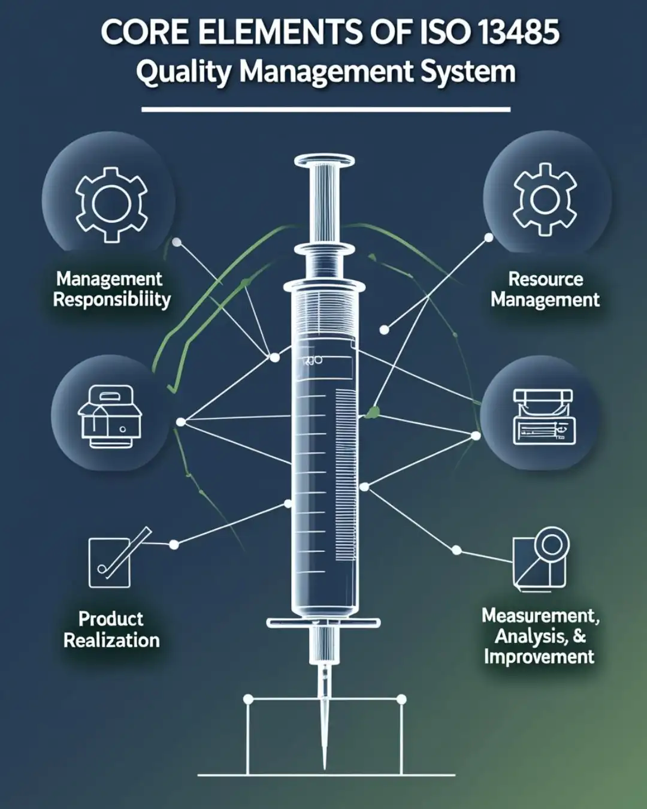
QMS Integration
Operationalizing AI Requirements in your Quality System
Article 17 – QMS (not called out in Proposed Solution) – ISO 13485 is Medical Device QMS
Integrate Article 8 – 15 into existing ISO 13485
Core QMS
Document a regulatory compliance strategy covering requirements, timelines, and responsibilities across jurisdictions to ensure legal alignment and audit readiness.
Plan for AI governance, risk assessment, documentation, and lifecycle management to ensure trustworthy AI deployments using healthcare specific standards (e.g. IEC 62304 ED2 in draft with AI requirements).
Integrate Medical Device AI processes into ISO 13485 processes, validation, risk management, and traceability across development and production.
Post-market monitoring plan detailing data collection, signal detection, trend analysis, and feedback loops for continuous safety monitoring.
Serious incident reporting procedures including detection, classification, timelines, internal escalation, regulatory notification, and corrective actions.
Notes:
AI Act requires an AI‑specific QMS, including lifecycle management, dataset governance, logging, and monitoring; must integrate with MDR QMS for medical devices
AI Act requires continuous post‑market monitoring, logging, performance drift detection, and reporting of serious incidents impacting fundamental rights or safety—aligned with MDR vigilance but with AI‑specific triggers.
Under the MDR the PRRC is mandatory; 2025 proposal relaxes availability/qualification rules, especially for SMEs. AI Act requires a designated responsible person ensuring compliance, but not a PRRC. Manufacturers must ensure oversight functionality aligns with MDR’s PRRC role.
MDCG – 2025-6: Conformity Assessment: For AI systems classified as high-risk MDAI under Article 6(1) (See Q2) the relevant conformity assessment procedure is determined by the MDR/IVDR.8

Slide 17






Enforcement
Financial Risks of Non-Compliance to EU AIA
Administrative Fines and Penalties for Breaching General Obligations (Articles 8-15)
Infringement Type
Max Fine (€)
Max Fine (%)
Prohibited AI Practices
35,000,000
7%
General Obligations (Art 8-15)
15,000,000
3%
False Information to Regulators
7,500,000
1%
Notes:
Article 5 violations – up to 35 million or 7% of global annual turnover, whichever is higher.
Article 5 – prohibits AI systems that manipulate, exploit vulnerabilities, or person social scoring, with limited exceptions for law enforcement.
Includes violating fundamental rights or EU values through manipulative, exploitative or discriminatory practices.
Manufacturers must ensure that deployers can understand the logic, limitations, and behaviour of AI components within a medical device.
This includes implementing safeguards, interpretation tools, and user interfaces that make AI outputs meaningful and trustworthy. The integration of these requirements throughout the high-risk MDAI lifecycle, design, documentation and record-keeping, labelling, and post-market surveillance ensures that MDAI is developed and deployed in a manner that supports patient safety, professional accountability, and public trust.

Slide 18
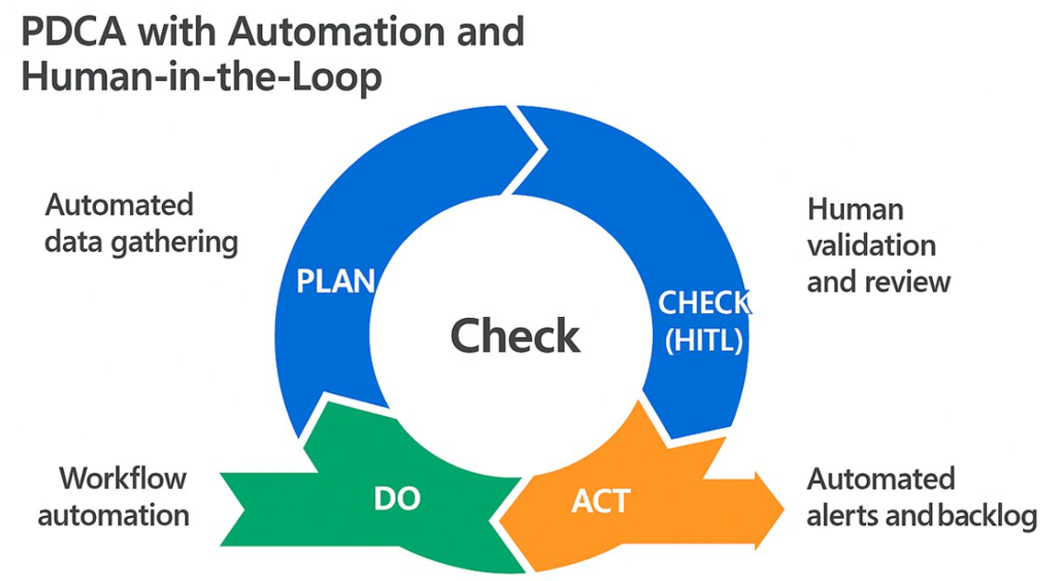
Automated compliance more competitive, innovative safe, happy customers
PDCA Cycle
© St John Lynch, N., DkIT 2026
Notes:
As stated in MDCG 2025-5: “The AIA requirements are complementary to the quality management system required under the MDR or IVDR and applicable to the overall MDAI. As the quality management system obligations under the AIA are specifically targeted to the AI system, additional requirements such as data and data governance, record-keeping, transparency, human oversight must be integrated, as appropriate (non-exhaustive).20 To ensure this complementarity and to avoid unnecessary administrative burden, manufacturers of AI systems may include the elements of the quality management system provided by the AIA as part of the existing quality management system provided by the MDR and IVDR”
“the development of harmonised European and international standards relevant to quality management systems for high-risk MDAI is ongoing, including under the framework of the AIA and MDR/IVDR, to support consistent implementation and compliance across manufacturers”.

Slide 19

Conclusion
2026 Regulatory Readiness Plan
Use this to support key strategic steps to secure EU market access and competitive advantage through compliance with Articles 8–15
This research is made possible with the financial support of Taighde Éireann – Research Ireland under Grant number 21/FFP-A/9255, a collaboration project for Trustworthy AI between
DkIT and UCD.
Notes:
As stated in MDCG 2025-6
The AIA complements the MDR/IVDR by introducing requirements to address hazards and risks for health, safety and fundamental rights specific to AI systems.
In line with the New Legislative Framework approach, this means a simultaneous and complementary application of the MDR/IVDR and the AIA for medical devices that contains one or more high-risk AI system.
In order to ensure consistency, avoid duplication and minimise additional burdens, manufacturers of MDAI, in accordance with paragraph 2 of Article 8 of the AIA (enters into force 2 Aug 2026), have a choice of integrating, as appropriate, the necessary testing and reporting processes, information and documentation they provide with regard to their MDAI into documentation and procedures that already established under the MDR/IVDR.
Article 8: Compliance with the Requirements indicates that the risk management system in Article 9 shall be taken into account also.

Slide 20
Definitions
According to MDCG 2019-115 , "medical device software" (MDSW) refers to software intended, either alone or in combination, to fulfil a medical purpose as defined in Article 2(1) MDR or Article 2(2) IVDR.
The AI Act (AIA) defines an AI system in Article 3(1) as a machine-based system that is designed to operate with varying levels of autonomy and that may exhibit adaptiveness after deployment, and that, for explicit or implicit objectives, infers, from the input it receives, how to generate outputs such as predictions, content, recommendations, or decisions that can influence physical or virtual environments.

Slide 21
Changes / Substantial Changes
Pre-determined change should not be understood as a change to the certified medical device or IVD under MDR Annex IX Section 4.10 and IVDR Annex IX Section 4.11. The above-specified rule should be included in the change management procedure of the MDR/IVDR device and in the technical documentation as provided in AIA Annex IV point 2(f).
It is essential that at the time of conformity assessment, the pre-determined changes must be clearly specified and adaptable to the device's evolving nature. This performance, documented in the technical documentation, should include a detailed description of the initial performance expectations alongside mechanisms for validating and managing changes that occur post-market.

