Slide 1
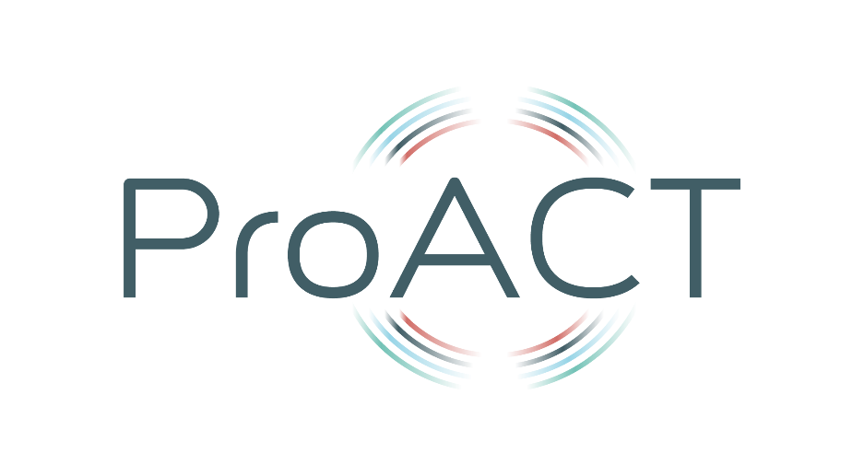




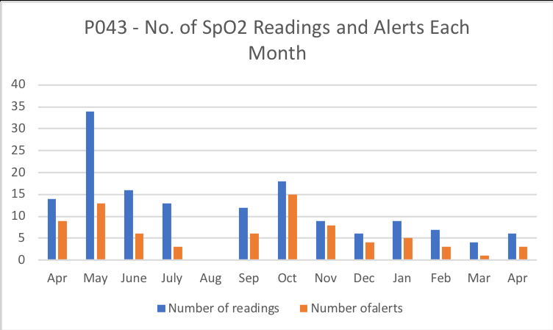
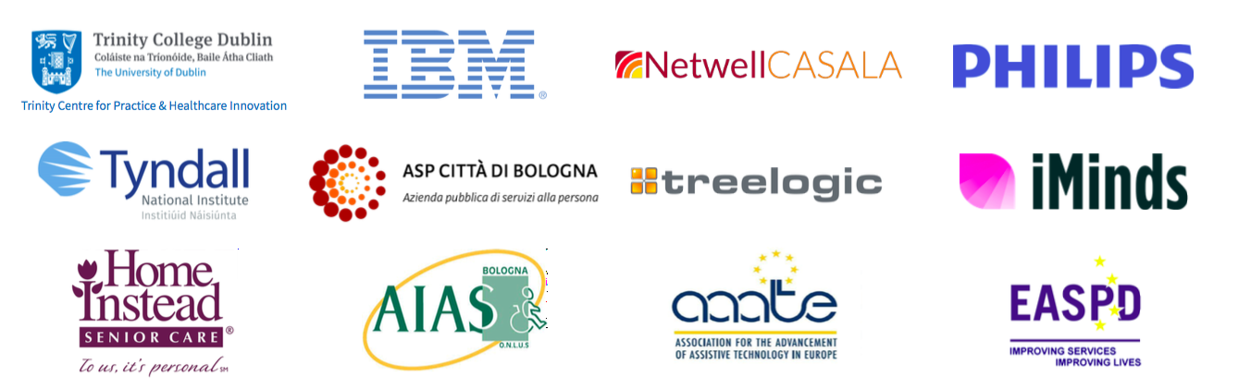
The Role of Telephone Nurse Triage in Supporting Older Adults with Multimorbidities to Self-Manage using Digital Technology
P. Sheridan*, J. Doyle*, S. Smith*, L. Tompkins**, J. Sheerin^, M. Galvin**,
E. Murphy**, M. Sillevis Smitt^^, C. van Leeuwen^^,
A. Jacobs^^, J. Dinsmore**
*NetwellCASALA, Dundalk Institute of Technology
**Trinity Centre for Practice & Healthcare Innovation, Trinity College Dublin
^Home Instead Senior Care, Dublin
^^imec-SMIT, Vrije Universiteit, Brussels
patricia.sheridan@dkit.ie
Funding: European Union Horizon 2020 Programme
Aim of the Study
Background
Research exploring the role that a telephone nurse triage service can play in holistically supporting older adults (65+ years) with multimorbidity to self-manage using digital technology is limited.
This study aims to fill that knowledge gap by outlining findings from a longitudinal study with older adults using a digital health system to self-manage, with a triage service monitoring alerts.
Multimorbidity, the presence of two or more chronic conditions, places a significant burden on health systems worldwide. People managing multimorbidity face burdensome and complex self-management routines, including symptom monitoring, communicating with multiple healthcare providers, managing multiple medications and processing and managing potentially conflicting advice on conditions.
With 50 million people in the EU living with multimorbidity; risk factors for its development increasing with age; and, the cost and complexity of its management, the need for solutions to assist people with self-management of their conditions is becoming more urgent.
ProACT, an EU H2020-funded project developed a digital integrated care system to support older people living with multimorbidity to self-manage their conditions, supported by a care network. Part of this project included a telephone nurse triage service to respond to any symptom alerts generated by those using the system.
Method
Research was conducted with participants in Ireland and Belgium (n=120) who managed two or more chronic conditions (Diabetes, Chronic Pulmonary Obstructive Disease and Congestive Heart Failure/Chronic Heart Disease) in a 12 month trial using ProACT.
Telephone triage support was provided by nurses in Ireland (n=4) and Belgium (n=5) to participants across both locations.
Supports provided to participants included monitoring and responding to health and wellbeing data and alerts from digital devices (blood pressure, blood glucose, pulse oximetry), education and motivation.
Focus groups with triage nurses and interviews with participants with multimorbidity were carried out. Thematic analysis was conducted on qualitative data using Nvivo 11 software.
Findings from Participants and Triage Nurses
The key theme to emerge from one-to-one interviews with participants in Ireland and Belgium was related to triage interventions which included medical and non-medical interventions such as education and provision of advice.
For some participants, advice from triage prompted a GP visit they had been avoiding: while for others reassurance from triage meant a GP visit was unnecessary.
Themes that emerged from focus group interviews with triage nurses across both research sites included the relationship between themselves and participants and the benefits of triage to participants.
The importance of rapport was frequently mentioned by triage nurses as a key factor in helping them to gather the correct information they needed to make appropriate diagnostic decisions.
Regular monitoring from triage nurses resulted in greater awareness by participants of their conditions and adoption of health behaviour strategies that resulted in an ‘early catch’ of issues.
Conclusion
Telephone triage, alongside a digital solution such as ProACT, has the potential to be effective in supporting older adults to better self-manage multimorbid health conditions and may also result in either decreased or more effective healthcare utilisation.
The ProACT project has received funding from the European Union’s Horizon 2020 research and innovation programme under grant agreement No. 689996. This document reflects the views only of the authors, and the European Union cannot be held responsible for any use which may be made of the information contained therein.

