Slide 1
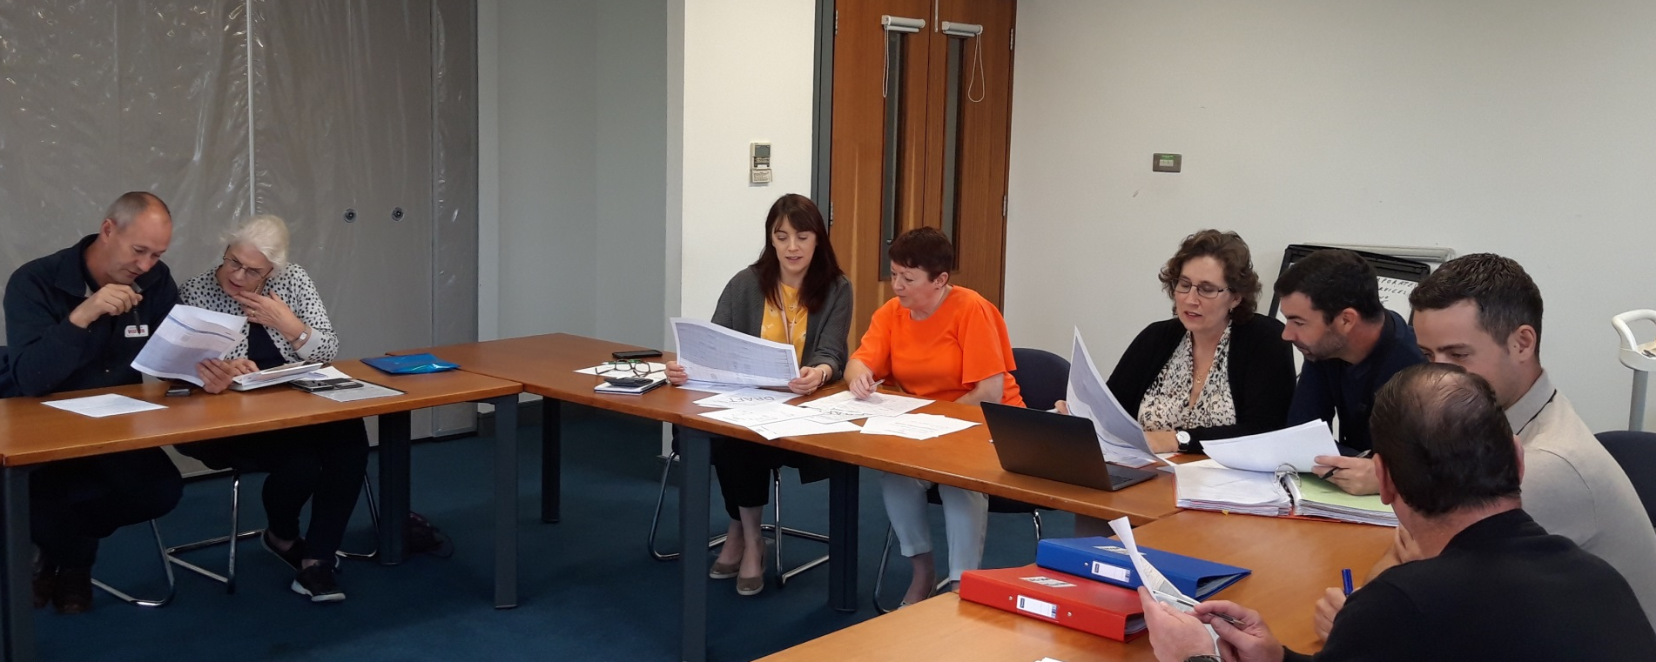
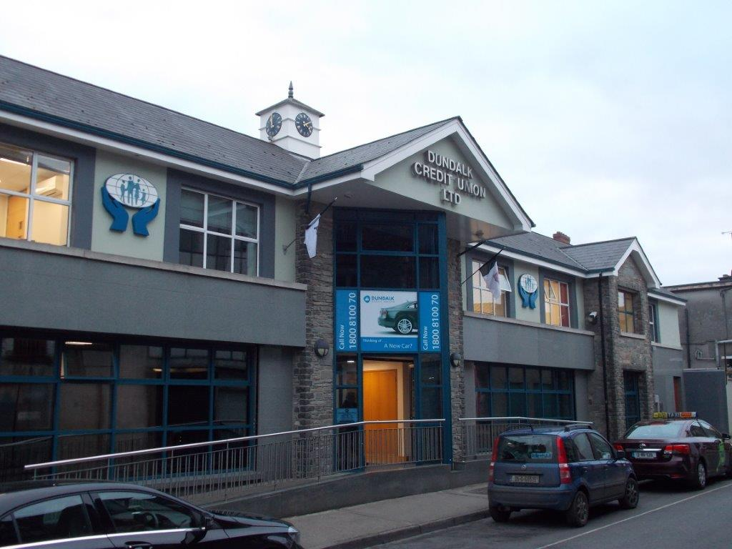

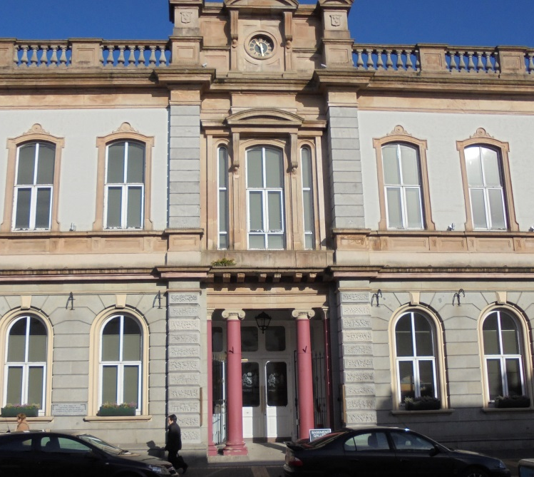
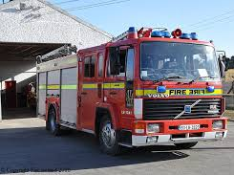
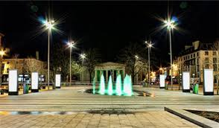
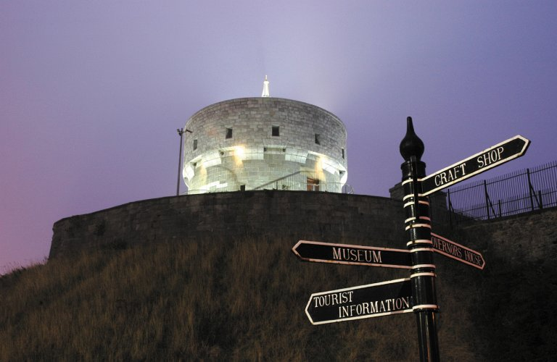
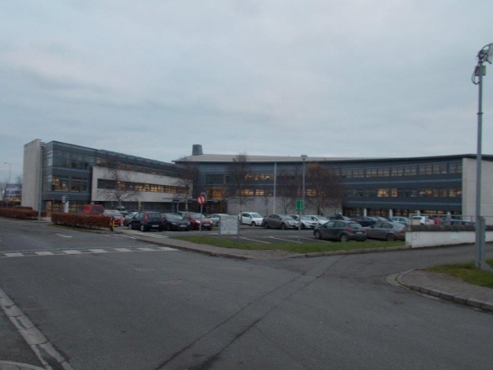
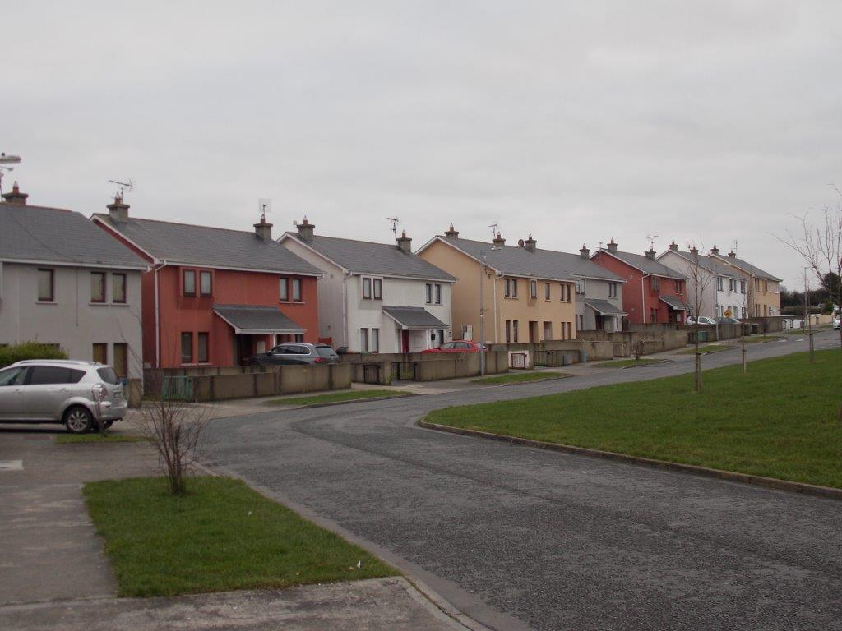
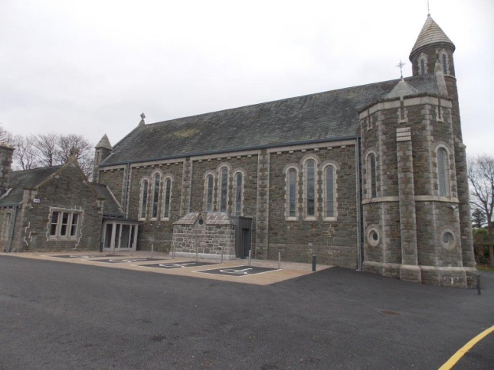
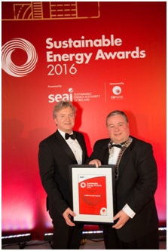



Better Energy Communities: Implementation of a Community Energy Grant Pilot Programme in Ireland
Suzanne Smith¹, Padraig O’Hora², and John Flynn³
¹NetwellCASALA at Dundalk Institute of Technology, ²Louth County Council Energy Department, ³Sustainable Energy Association of Ireland
Introduction
,
New programmes and learnings are needed for clean, renewable, local, and smart energy adoption.
Achieving successful energy efficiency savings requires the mobilization of all community sectors
All stakeholders are not equally informed, motivated or empowered to contribute to targets set by policymakers.
Objectives
Use a Living Lab approach to:
Harness the synergistic potential of local authority, business, community and other public sector energy projects, acting in unison to deploy multiple measures which might not otherwise have been possible
Encourage investment behavior relating to structural energy efficiency works in both domestic and non-domestic settings.
Facilitate participating energy suppliers to engage in the delivery of energy credits to community energy projects
Method
A pilot Community Energy Grant (CEG) scheme, led by the local authority Energy Team, in partnership with NetwellCASALA Living Lab at Dundalk Institute of Technology (DKIT), collaborating with local community groups, private and public sector organisations and individual citizens.
Regular co-stakeholder planning and cooperation meetings as a central engagement method
BER reviews and energy use evaluations provided quantitative evidence of achieved energy savings
Focus groups, case studies and interviews with participant stakeholders were also conducted at the conclusion of each annual project.
Results
Between 2015 and 2019, structural works completed included:
Domestic upgrades (n=592), in both private and local authority homes,
A range of non-domestic upgrade projects (n=69) encompassing private, public and voluntary/community organisations.
Success is further reflected in:
10.7 GWh in energy savings delivered
Saving of 4,031 Tons of CO₂ emissions
Improved community-based energy knowledge and awareness, evidenced by repeat CEG project submissions by community stakeholders
Conclusion
The piloted CEG multi-stakeholder collaborative engagement model is informing the Irish strategic response to climate change. One result is the scheduled roll out of a substantial and effective national Energy Efficiency Upgrade scheme, supporting regional stakeholders to co-create better and more sustainable communities in which to live and work.
The replication of community and citizen-centered program models should facilitate continued co-learning, mentoring, problem-solving and peer support for sustained energy efficiency behavior change ensuring local and regional communities can contribute to the delivery of national and international targets set for 2030 and beyond.
4124
Suzanne Smith
Padraig O’Hora
John Flynn
Suzanne.smith@dkit.ie
Padraig.o’hora@louthcoco.ie
John.Flynn@seai.ie
www.netwellcasala.org
www.louthcoco.ie
www.seai.ie
Notes:
Insert your abstract code in the orange circle on the bottom (eg. Code #4100)

