Slide 1





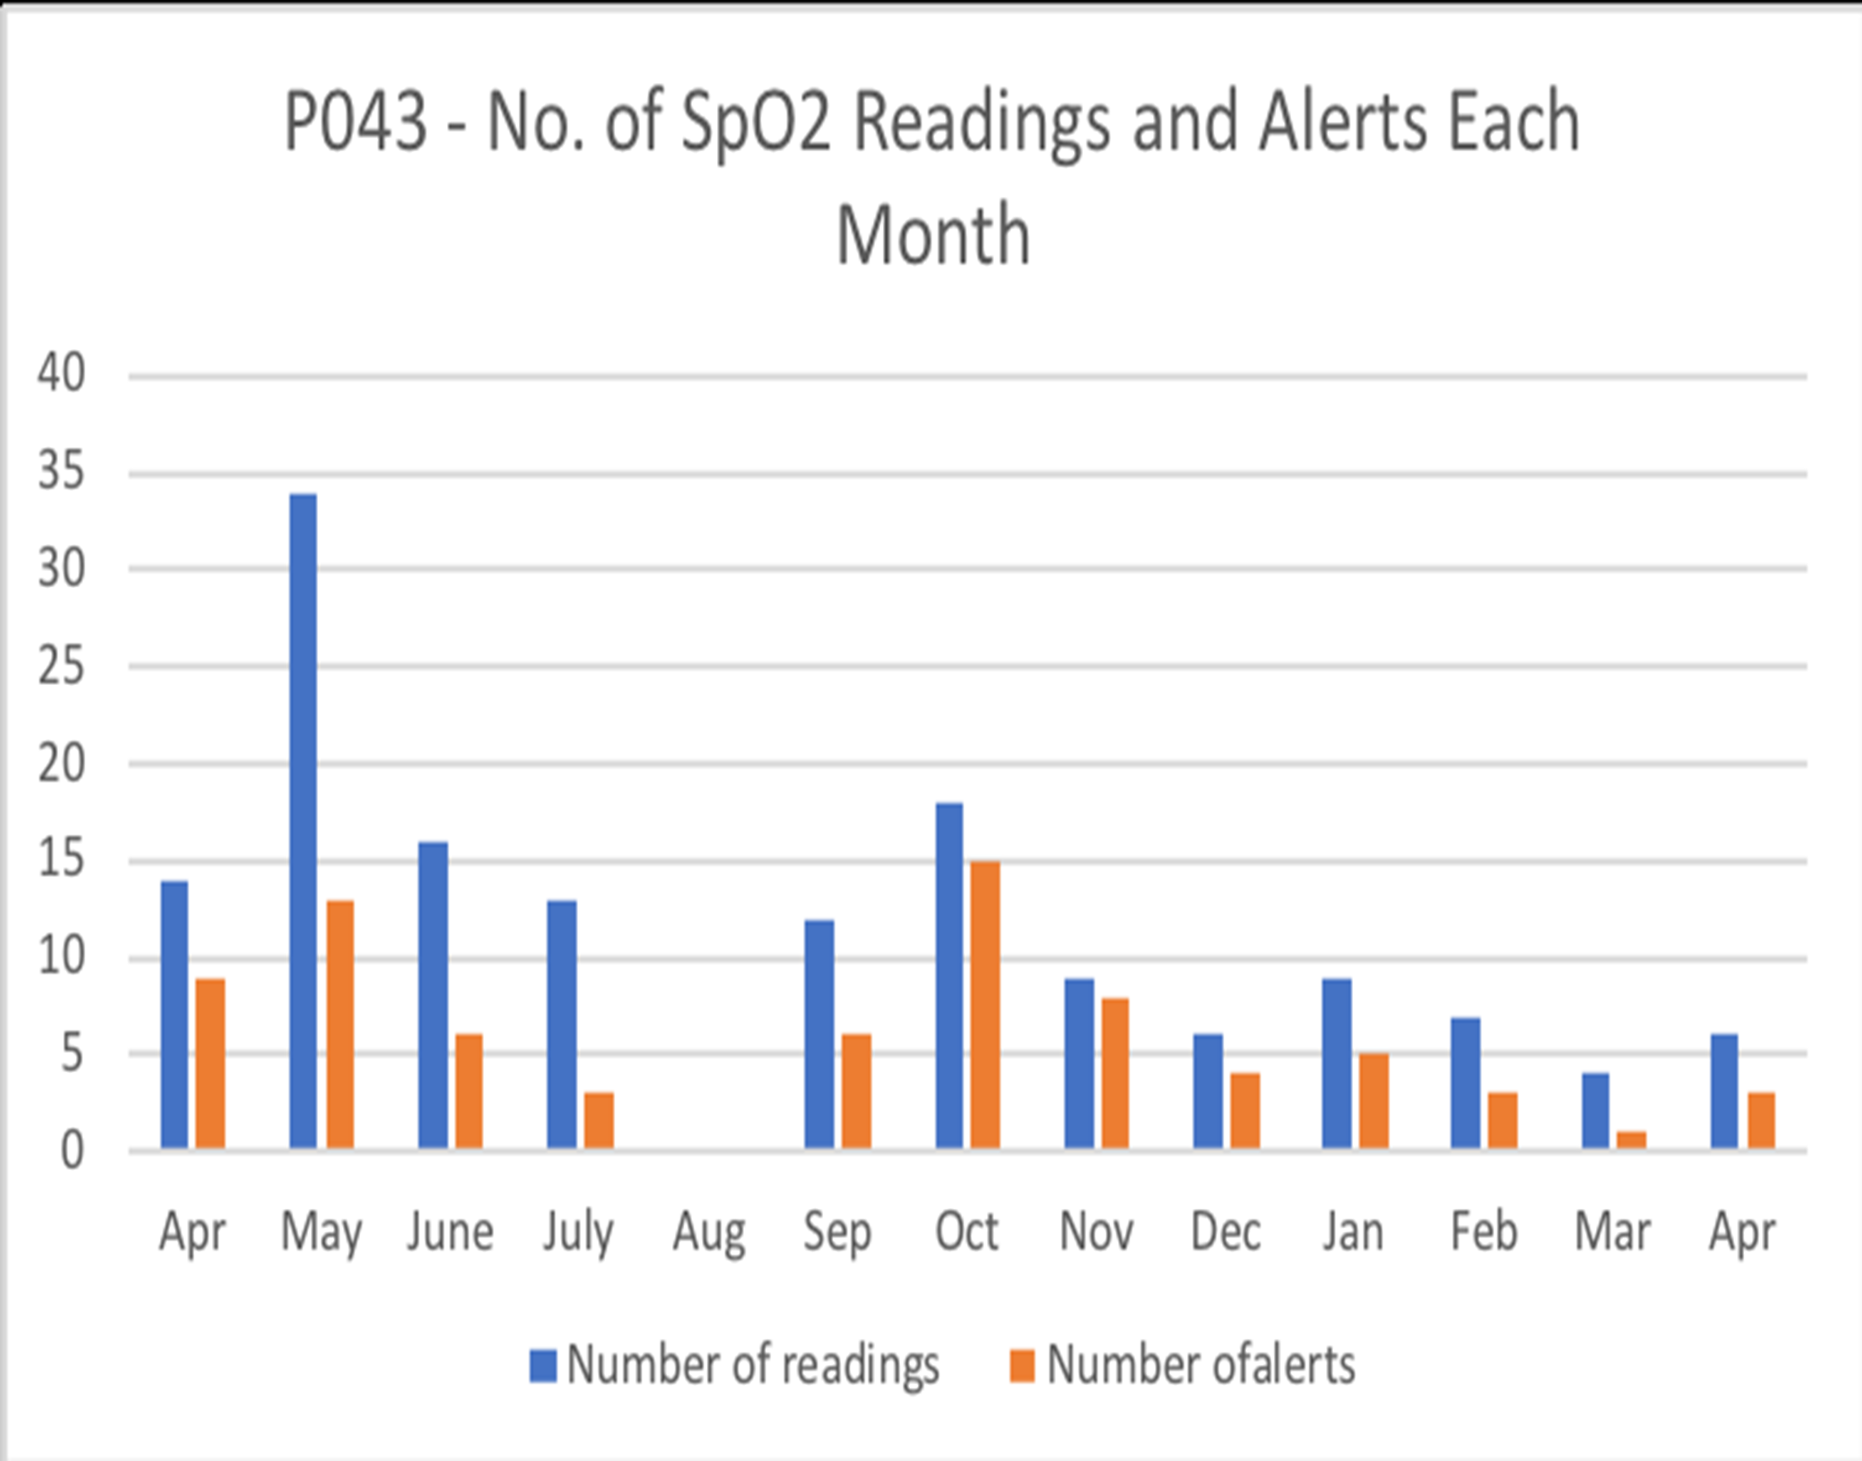


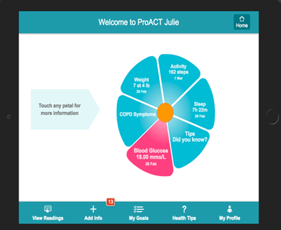


The Role of Telephone Triage Nurses in Supporting Older Adults with Multimorbidities in Ireland and Belgium to Self-Manage using Digital Technology
Patricia Sheridan*, Julie Doyle*, Suzanne Smith*, Cora van Leeuwen^, Myriam Sillevis Smitt^, An Jacobs^, John Dinsmore**
*NetwellCASALA, Dundalk Institute of Technology
^imec-SMIT, Vrije Universiteit, Brussels
**Trinity Centre for Practice & Healthcare Innovation, Trinity College Dublin
INTRODUCTION
METHODS
CONCLUSION
Multimorbidity, the presence of two or more chronic conditions, places a significant burden on health systems worldwide. People managing multimorbidity face burdensome and complex self-management routines, including symptom monitoring, communicating with multiple healthcare providers, managing multiple medications and processing and managing potentially conflicting advice on conditions.
With 50 million people in the EU living with multimorbidity; risk factors for its development increasing with age; and, the cost and complexity of its management, the need for solutions to assist people with self-management of their conditions is becoming more urgent.
ProACT, an EU H2020-funded project developed a digital integrated care system to support older people living with multimorbidity to self-manage their conditions, supported by a care network. Part of this project included a telephone nurse triage service to respond to any symptom alerts generated by those using the system.
Research was conducted with participants in Ireland and Belgium (n=120) who managed two or more chronic conditions (Diabetes, Chronic Pulmonary Obstructive Disease and Congestive Heart Failure/Chronic Heart Disease) in a 12 month trial using ProACT.
Telephone triage support was provided by nurses in Ireland (n=4) and Belgium (n=5) to participants across both locations.
Supports provided to participants included monitoring and responding to health and wellbeing data and alerts from digital devices (blood pressure, blood glucose, pulse oximetry), education and motivation.
Focus groups with triage nurses and interviews with participants with multimorbidity were carried out. Thematic analysis was conducted on qualitative data using Nvivo 11 software.
Telephone triage, alongside a digital solution such as ProACT, has the potential to be effective in supporting older adults to better self-manage multimorbid health conditions and may also result in either decreased or more effective healthcare utilisation.
Further research is required to explore the ways that triage nurses promote self-management of multimorbid chronic illnesses and the impact they have on older adults engagement with digital technology and resultant health behaviour changes.
RESULTS
Acknowledgement
OBJECTIVES
The key theme to emerge from one-to-one interviews with participants in Ireland and Belgium was related to triage interventions which included medical and non-medical interventions such as education and provision of advice
For some participants, advice from triage prompted a GP visit they had been avoiding, while for others reassurance from triage meant a GP visit was unnecessary.
Themes that emerged from focus group interviews with triage nurses across both research sites included the relationship between themselves and participants and the benefits of triage to participants.
The importance of rapport was frequently mentioned by triage nurses as a key factor in helping them to gather the correct information they needed to make appropriate diagnostic decisions.
Regular monitoring from triage nurses resulted in greater awareness by participants of their conditions and adoption of health behaviour strategies that resulted in an ‘early catch’ of issues.
The ProACT project received funding from the European Union’s Horizon 2020 research and innovation programme under grant agreement no. 689996.
Contact us at:
patricia.sheridan@dkit.ie @casalatweet
www.netwellcasal.org @proact2020
Research exploring the role that a telephone nurse triage service can play in holistically supporting older adults (65+ years) with multimorbidity to self-manage using digital technology is limited.
This study aims to fill that knowledge gap by outlining findings from a longitudinal study with older adults using a digital health system to self-manage, with a triage service monitoring alerts.

