Slide 1




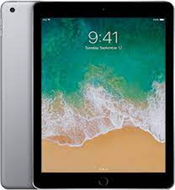
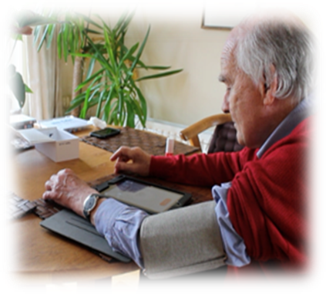

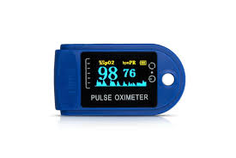
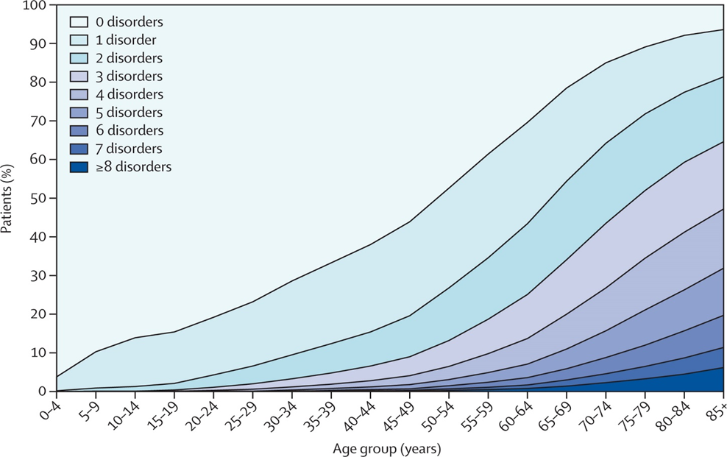
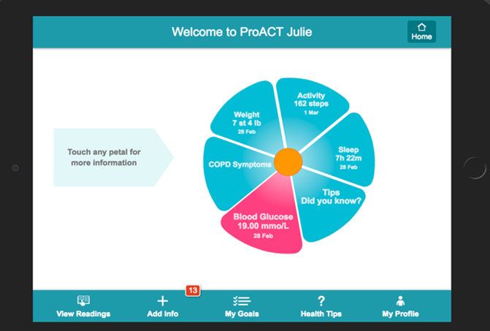
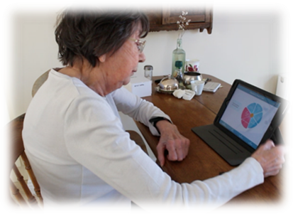

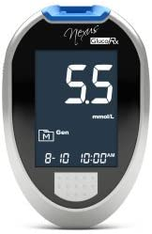
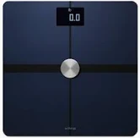


The Role of Telephone Triage Nurses in Supporting People with Multimorbidity to Digitally Self-Manage Their Health
Patricia McAleer¹, Julie Doyle¹, John Dinsmore²
1 NetwellCASALA, Dundalk Institute of Technology
2 Trinity Centre for Practice in Healthcare Innovation, Trinity College Dublin
patricia.mcaleer@dkit.ie
netwellcasala.org
Aim of the Study
Background
To explore the role of a nurse-led telephone triage service in supporting digital self-management of multimorbid conditions.
Remote monitoring of health is increasing, driven by an ageing population who frequently live with chronic illness.
Multimorbidity (the presence of two or more chronic conditions) affects 50 million people in the EU, the occurrence of which increases with age.
Multimorbidity imposes a significant burden on those who live with it. That burden includes symptom monitoring, attending multiple medical appointments, managing numerous medications and following contradictory lifestyle advice.
The cost and complexity of managing multimorbidity to healthcare systems, and shortages of medical staff, necessitate digital solutions to support people aged 65+ years to self-manage their illnesses.
However, older people with complex conditions can experience challenges in using digital technology: human support from a nurse-led telephone triage monitoring service offers a potential solution.
Method
This PhD research project was part of the larger SMILE project undertaken in the South-East of Ireland.
Participants used the ProACT CareApp with a range of digital devices to self-manage their conditions.
Due to Covid-19 restrictions, one focus group on Zoom was conducted with three telephone triage nurses (TTNs), and telephone interviews were conducted with a sub-set of 10 older people with multimorbidity (PwMs).
Qualitative data were thematically analysed using Nvivo 12 software.
Prevalence Rates of Multimorbidity
ProACT CareApp with Suite of Smart Devices
‘It’s nice to know that I’m being monitored. That’s the jewel, like’ (P01)
‘It was that peace of mind…you never felt like you were imposing or that. It was the reassurance and the calmness that they dealt with you as well’ (P09)
Findings
Six themes related to participants’ experiences of being supported by TTNs to use digital technology emerged: (i) the impact and challenges of multimorbidity; (ii) engagement in self-management; (iii) the relationship between PwMs and TTNs; (iv) the role of the TTNs; (v) technology; and (vi) the benefits of the SMILE programme.
‘They know though that we have their backs and therefore they know that whatever we’re telling them to do or asking them to do it’s for their benefit so they’ll have quality of life’ (TTN01)
‘You could end up having the same conversation with some of them for quite a few weeks and then one day they’ll take it on board. But we’re like a stone in the shoe. We keep ringing you know. We keep an eye on them’ (TTN03)
Conclusions and Implications
Selection of Quotes from PwMs and TTNs
The relationship between TTNs and PwMs, and the motivating effect that the TTNs had on participants is important in enabling engagement with digital self-management.
Further research will assess digital engagement between two groups: those with support from TTNs and those without it.
Funding acknowledgement: PhD funding granted under Landscape Funding

